Slide 1


Human vs. Computational Paleography: A Case of Ms. Hunt. 200
Berat Kurar-Barakat
Daria Vasyutinsky Shapira
Sharva Gogawale
Mohammad Suliman
Omer Ventura
Gal Grudka
Nachum Dershowitz
This research was funded in part by the European Union (ERC, MiDRASH, Project No. 101071829). Views and opinions expressed are, however, those of the authors only and do not necessarily reflect those of the European Union or the European Research Council Executive Agency. Neither the European Union nor the granting authority can be held responsible for them.

Slide 2
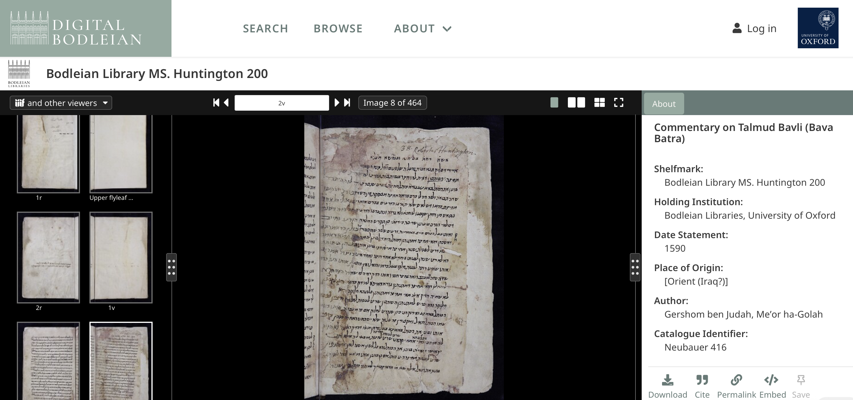

Slide 3
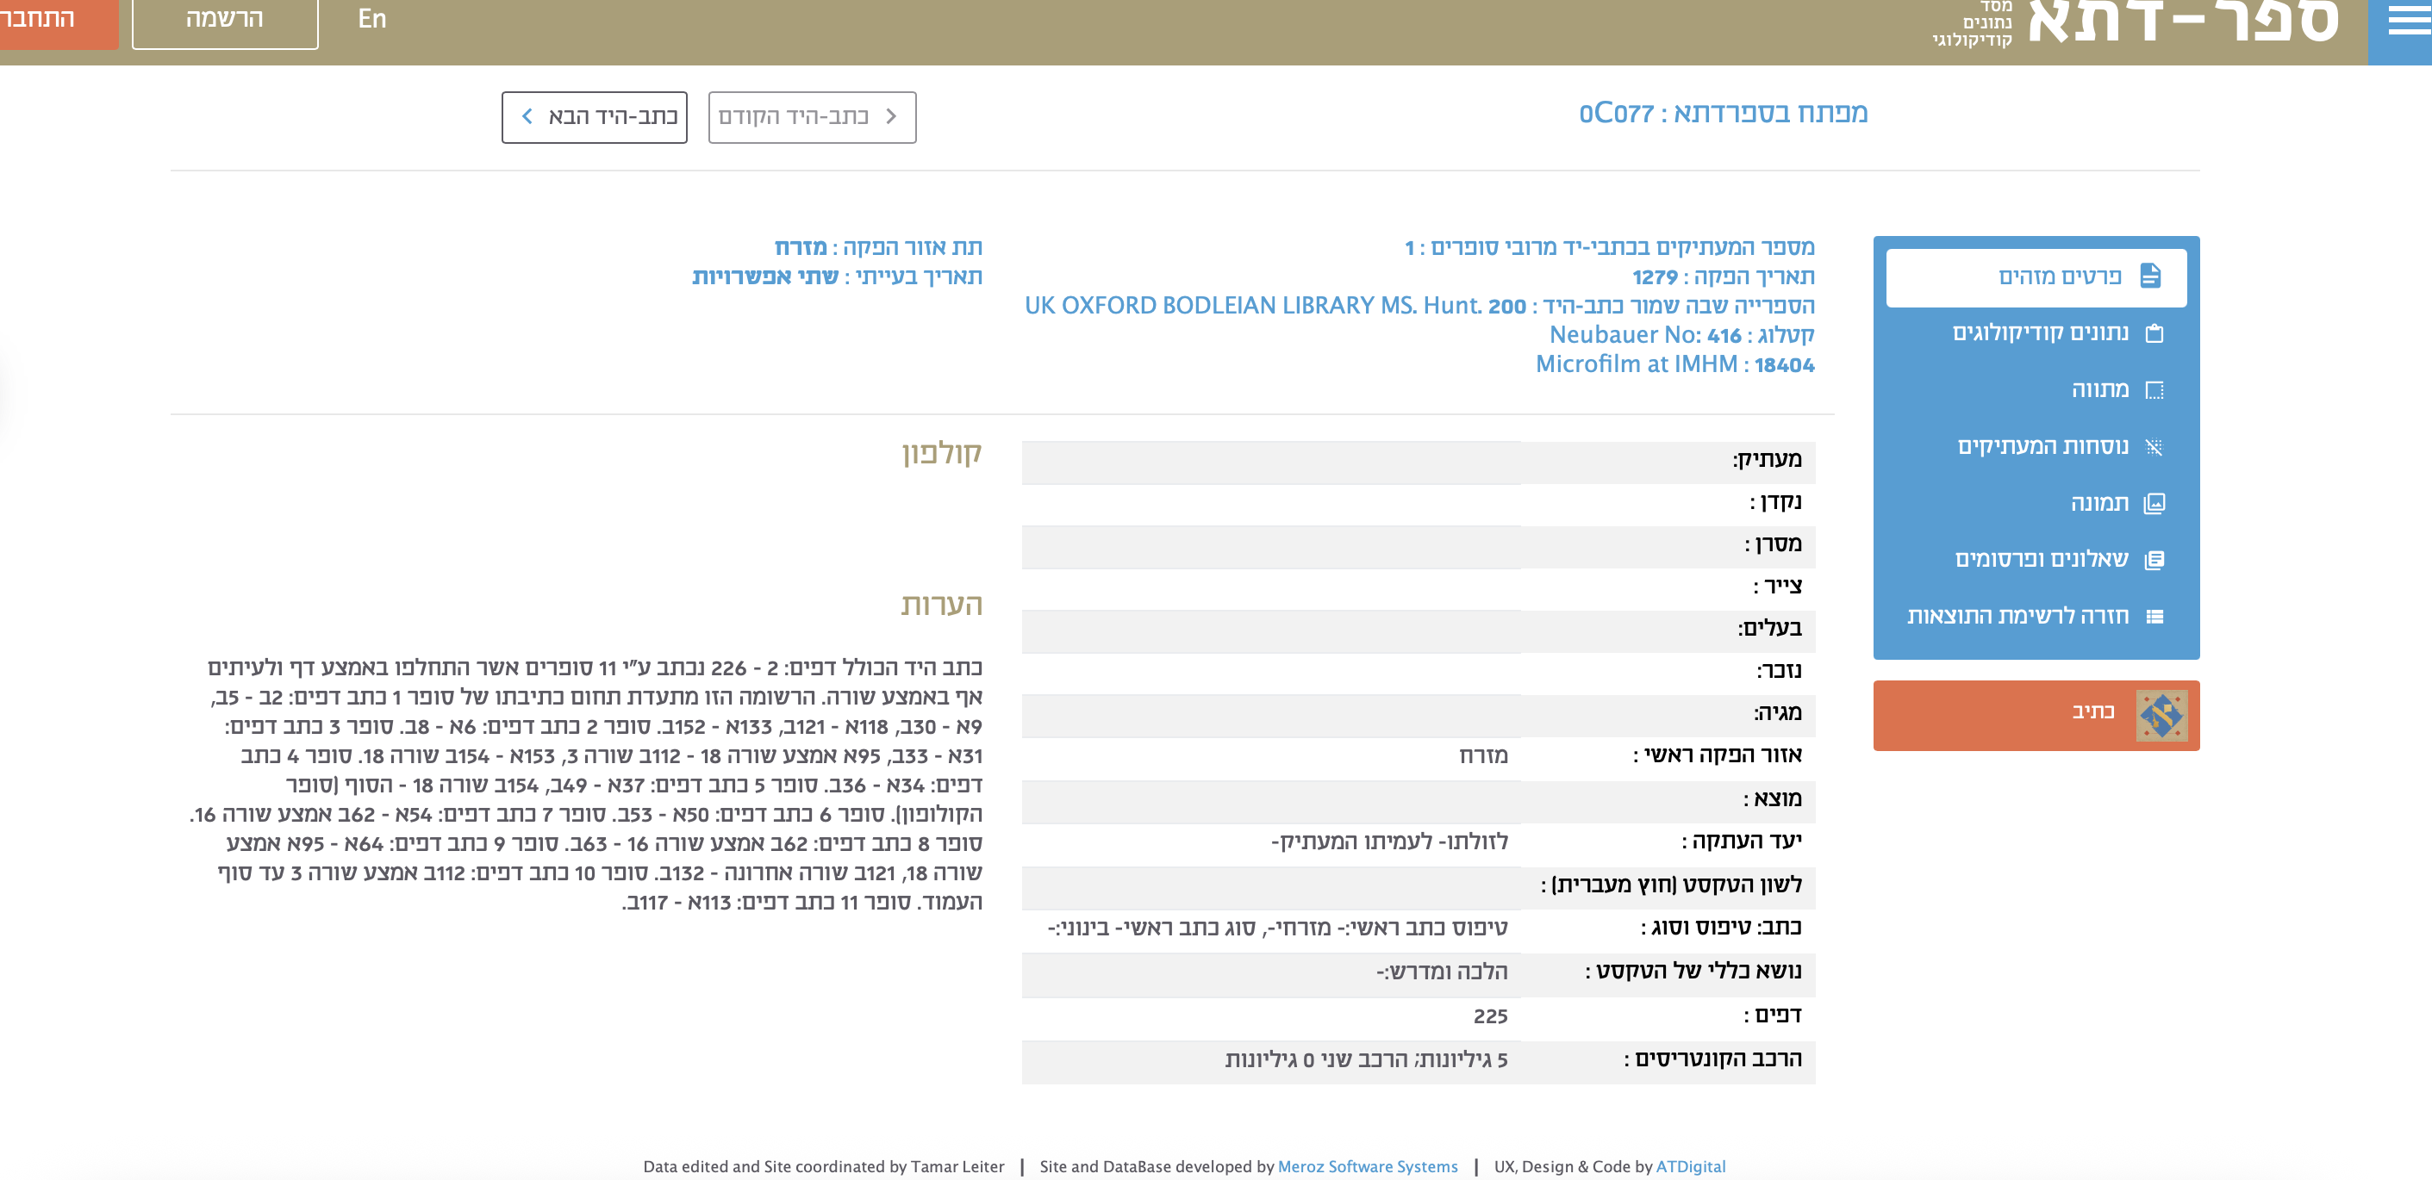
Judith Olszowy-Schlanger, “User-Production of Hebrew Manuscripts Revisited: the Case of Manuscript Oxford,
Bodleian Library, Huntington 200,” in David Durand-Guédy and Jürgen Paul, eds., Personal Manuscripts: Copying, Drafting, Taking Notes (Berlin: de Gruyter, 2023), 335-357.

Slide 4
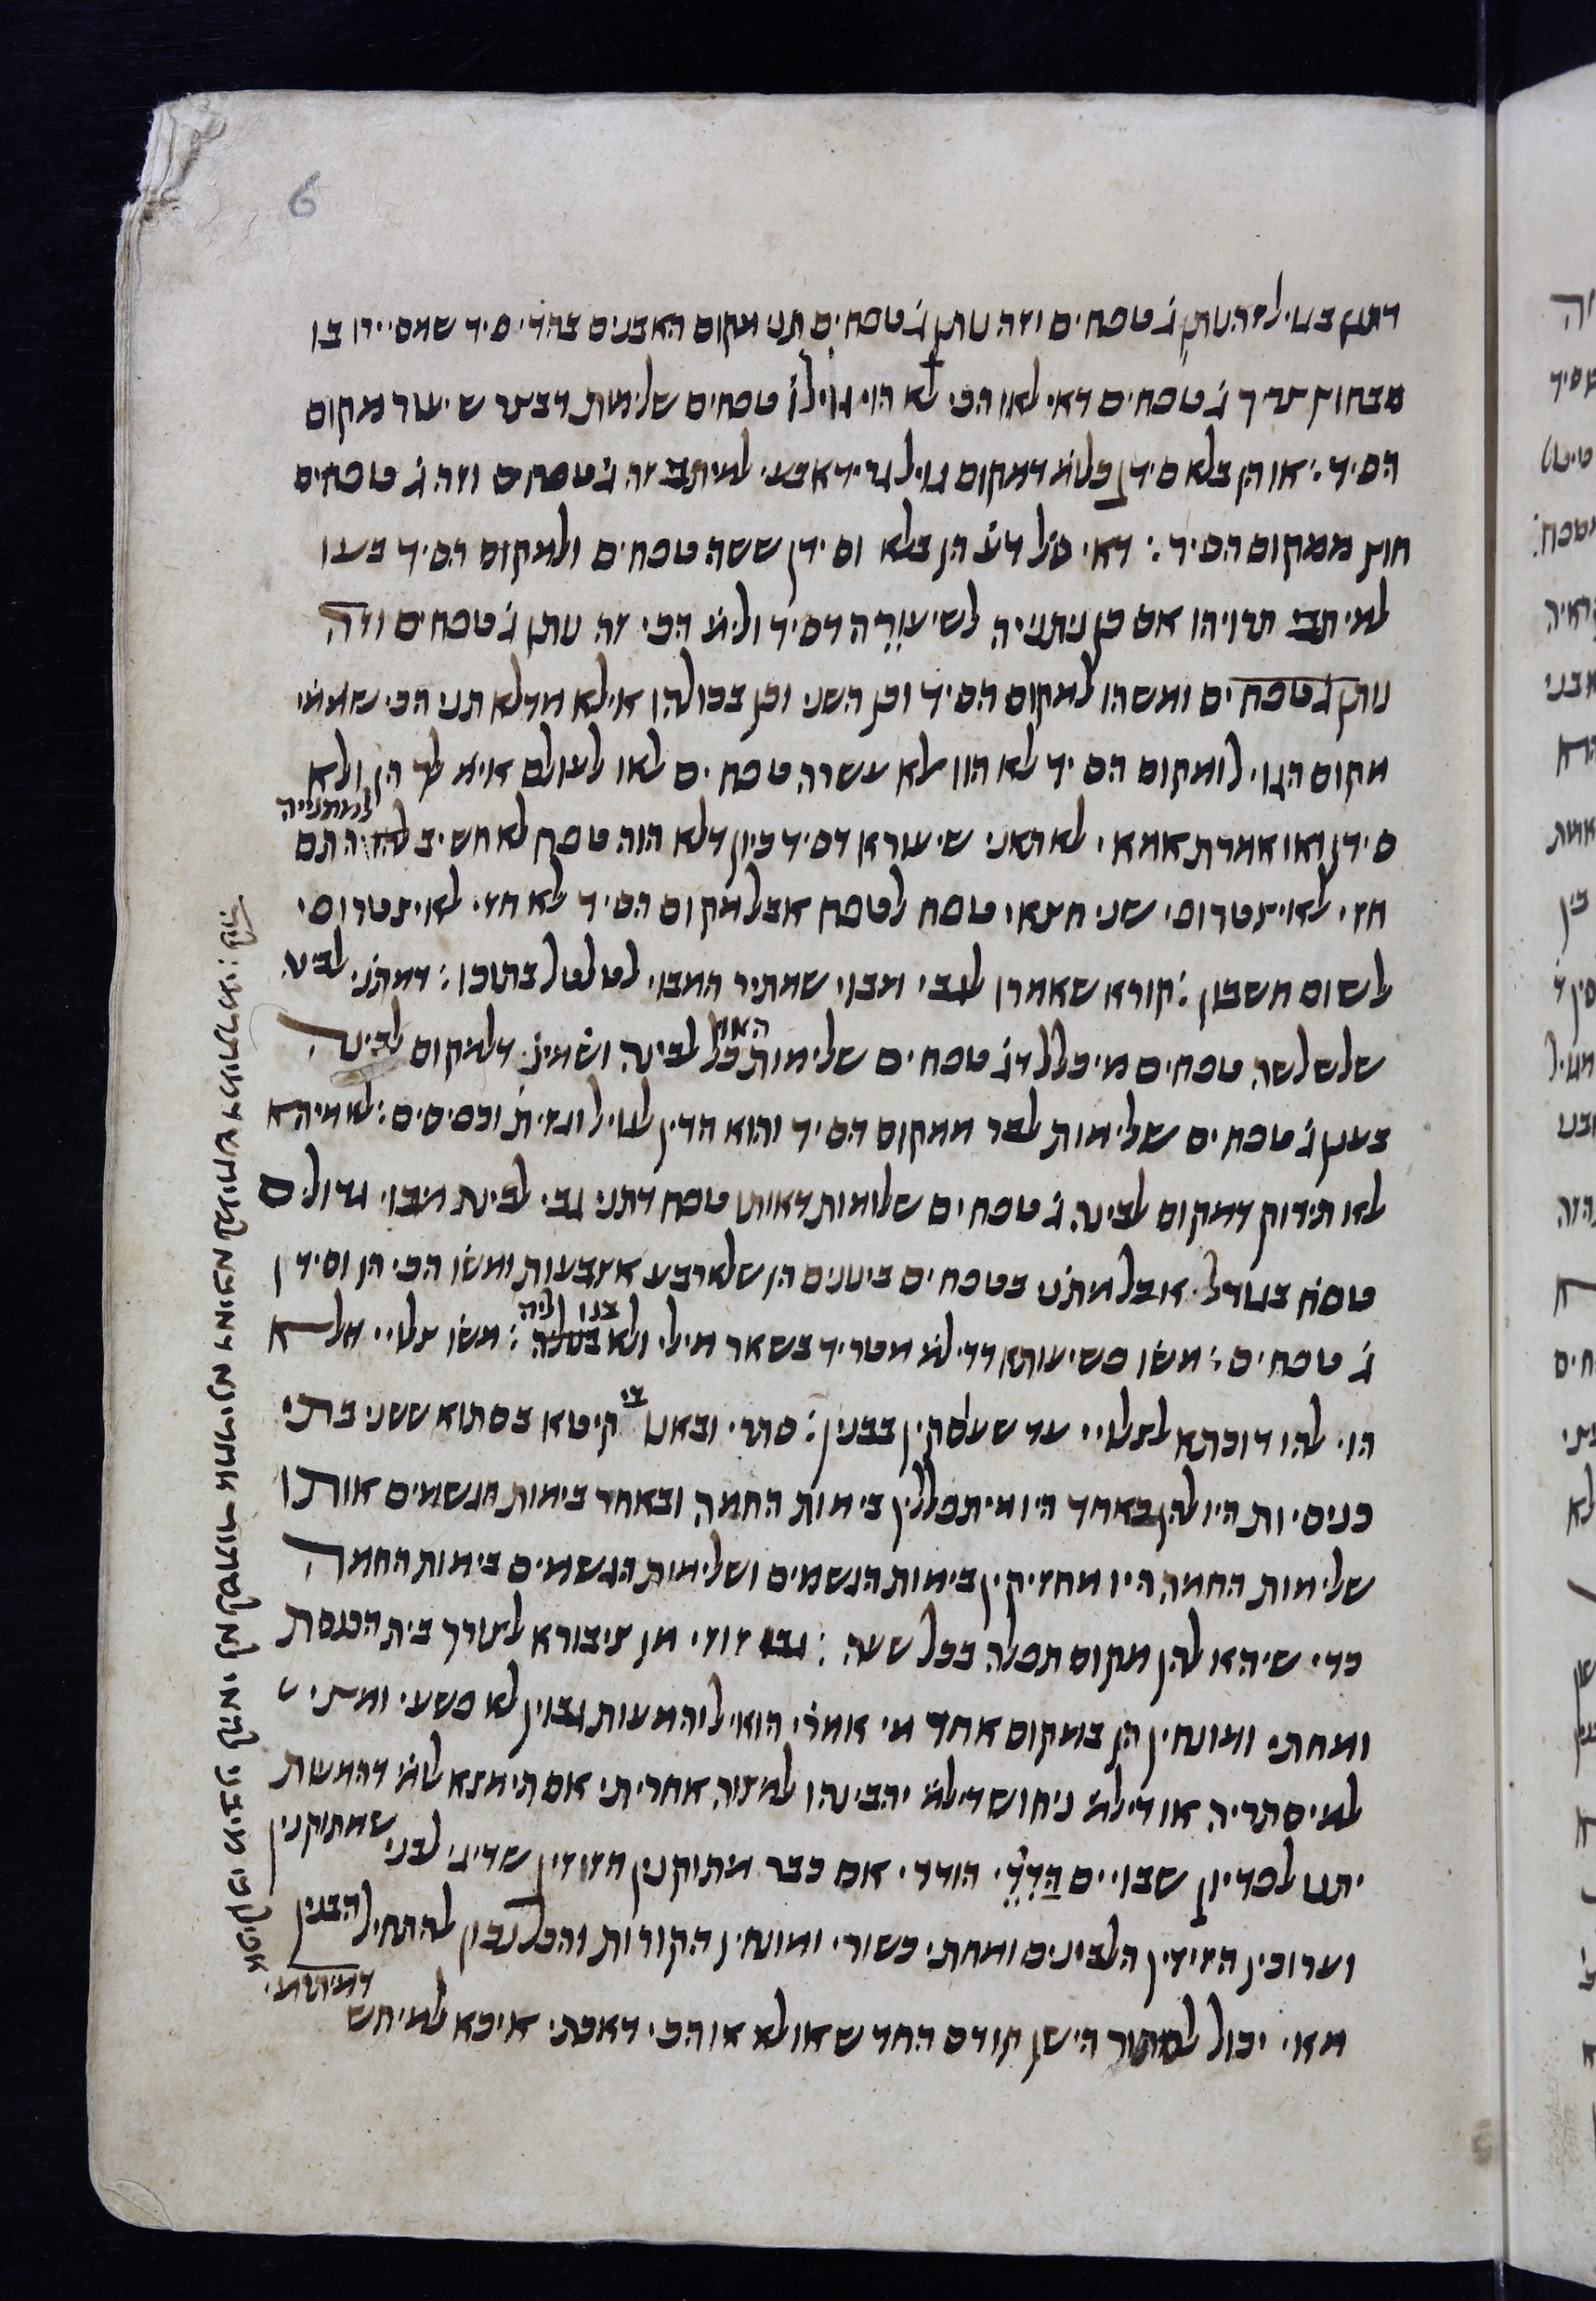
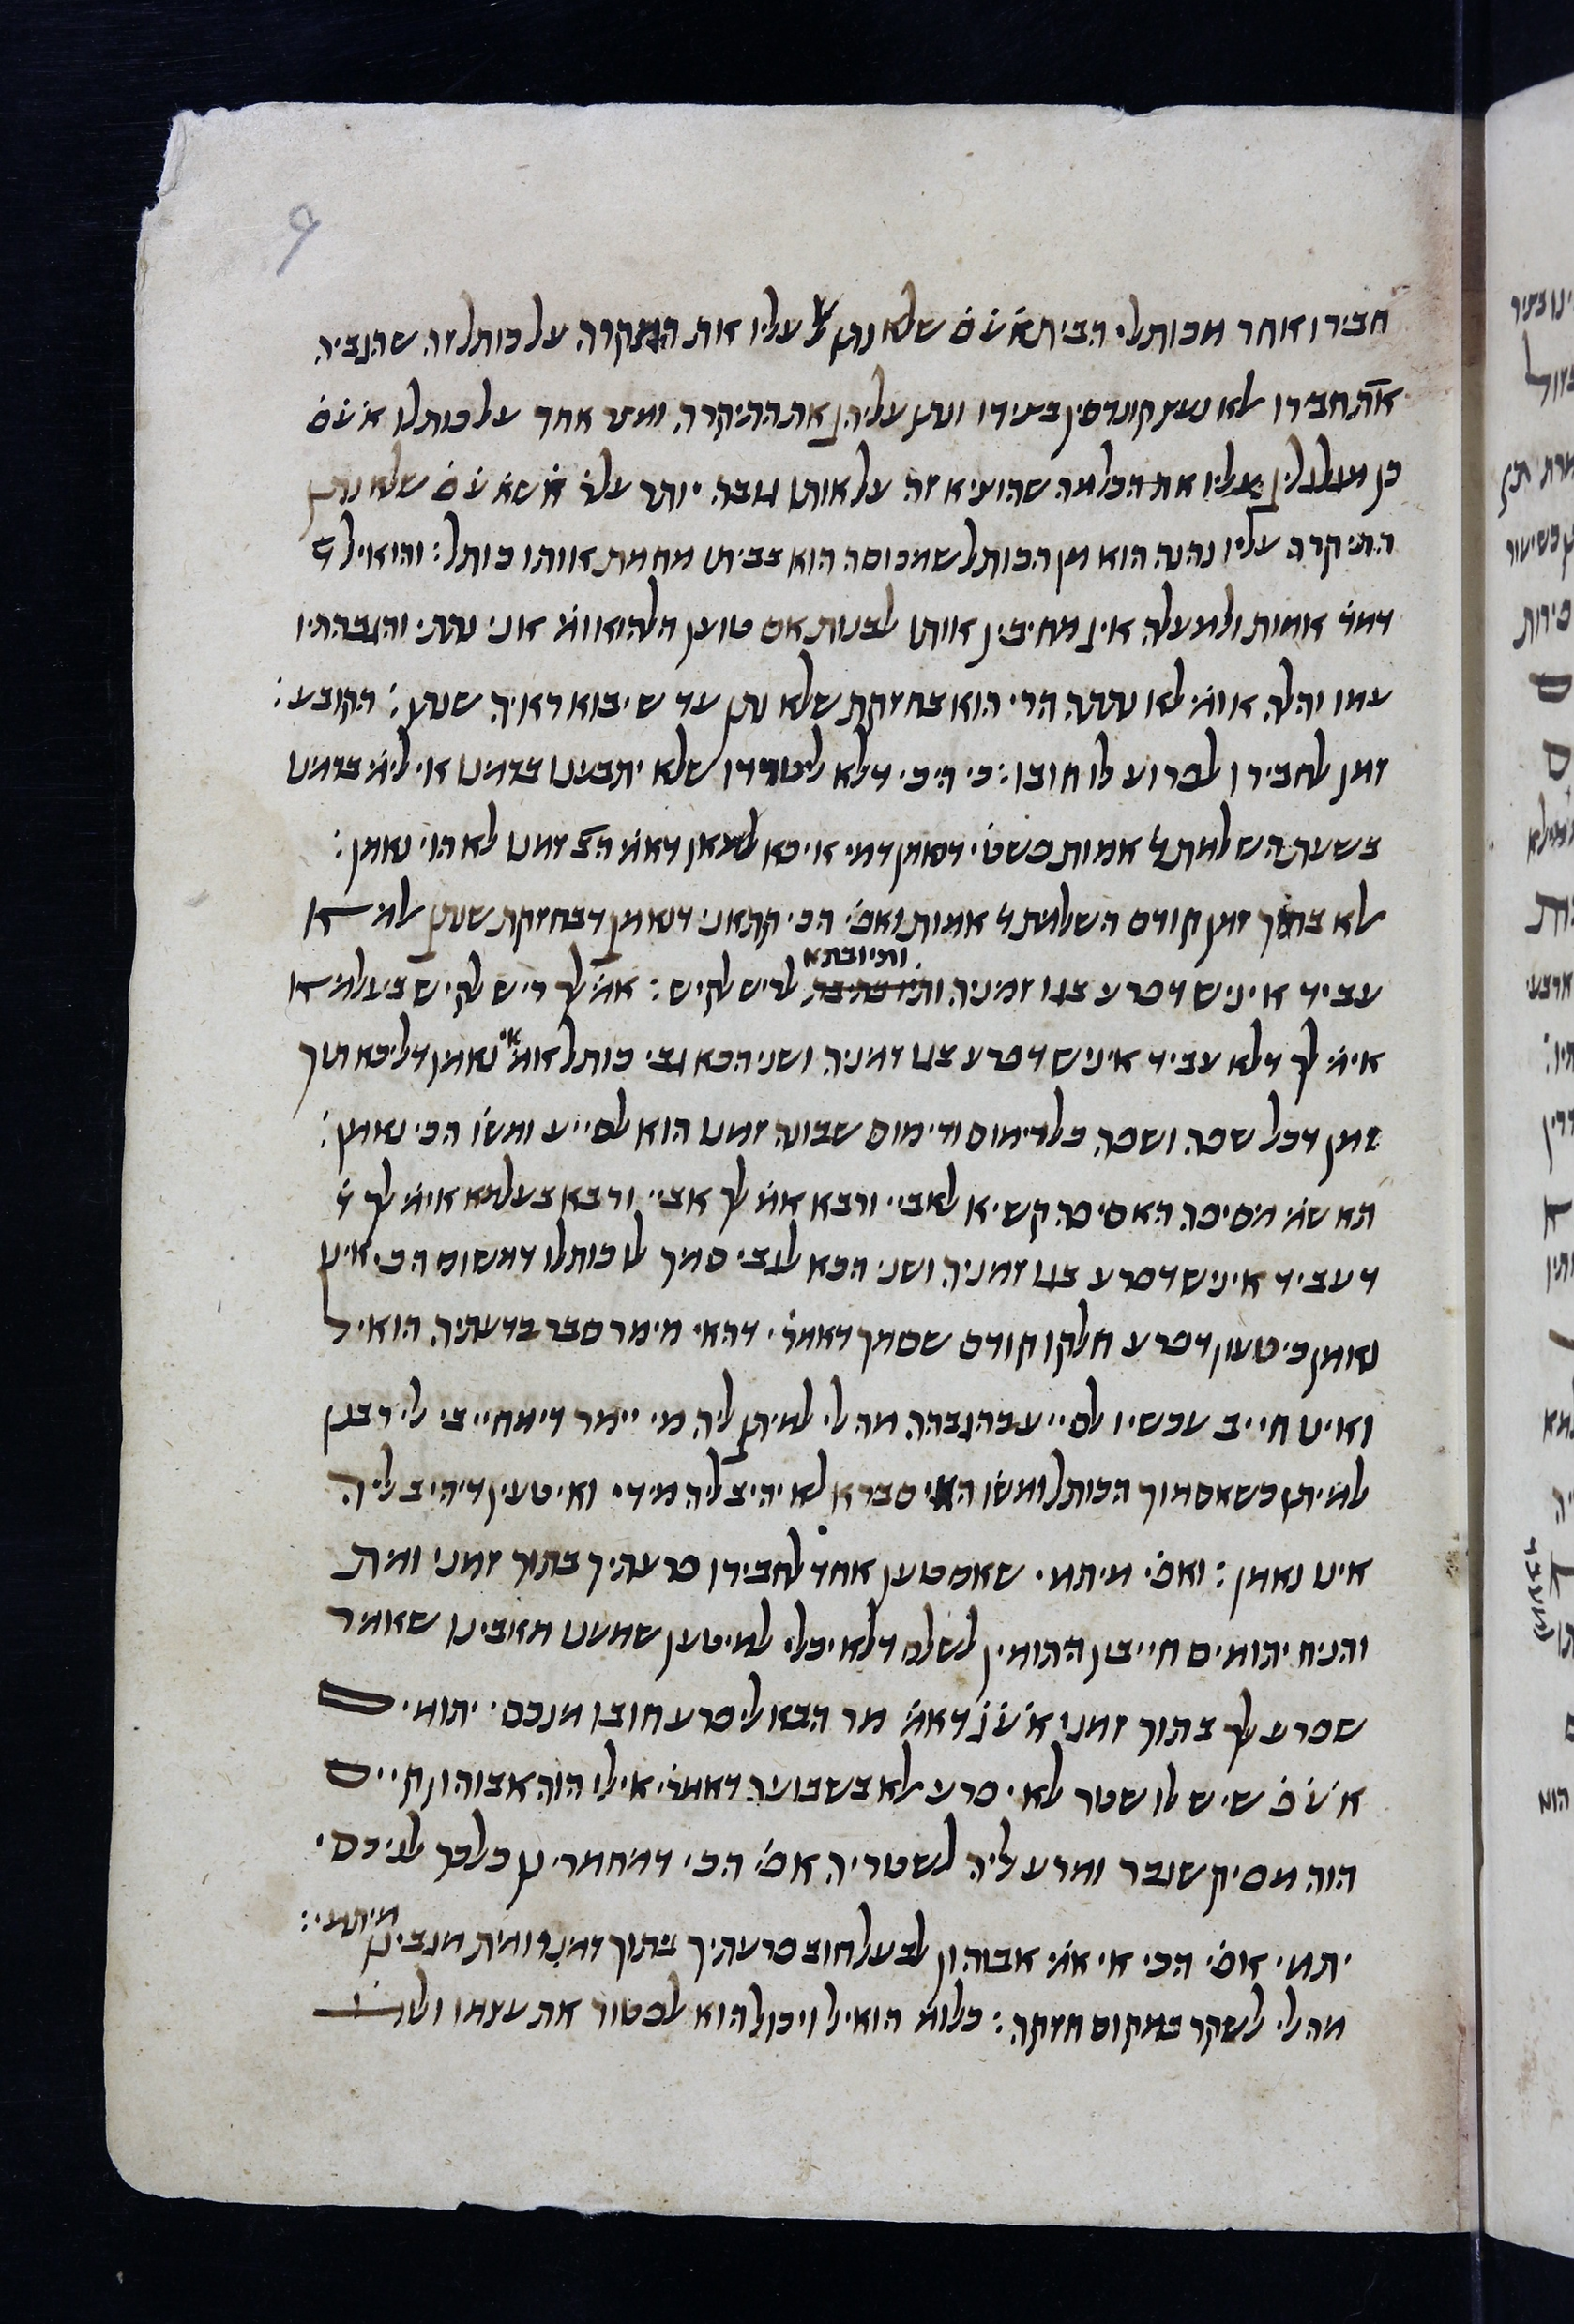
Hunt 200
6r (Hand 1)
9r (Hand 2 in
Sfardata, hand 1 in
Judith Schlanger)

Slide 5
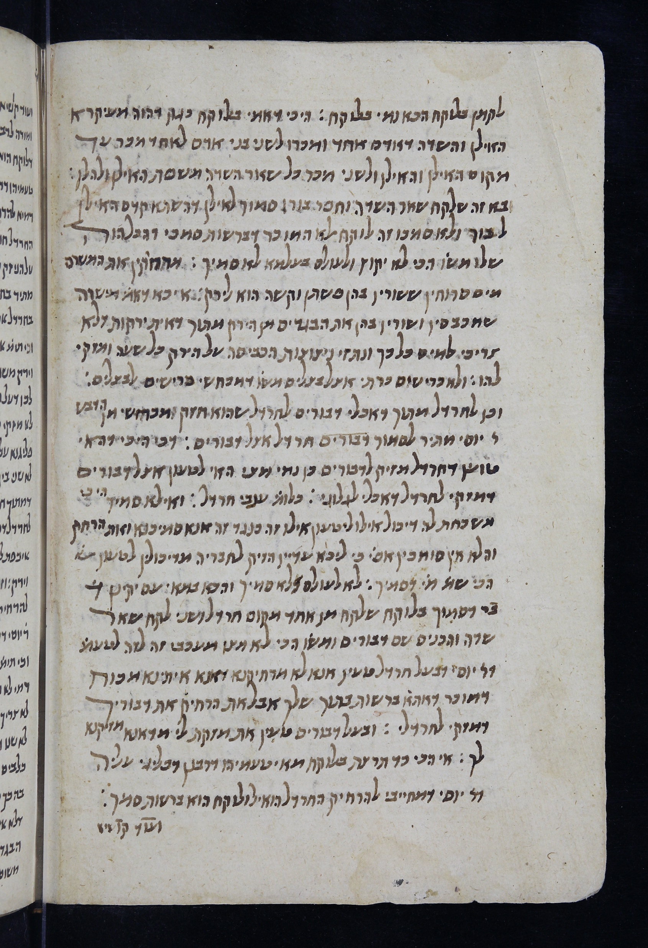
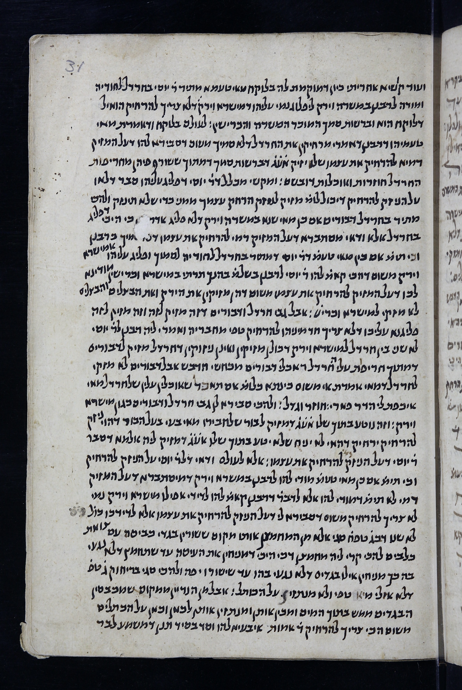
Hunt 200
30v (Hand 1 in
Judith Schlanger,
Hand 2 in Sfardata )
31r (Hand 3 in
Sfardata, hand 2 in
Judith Schlanger)

Slide 6
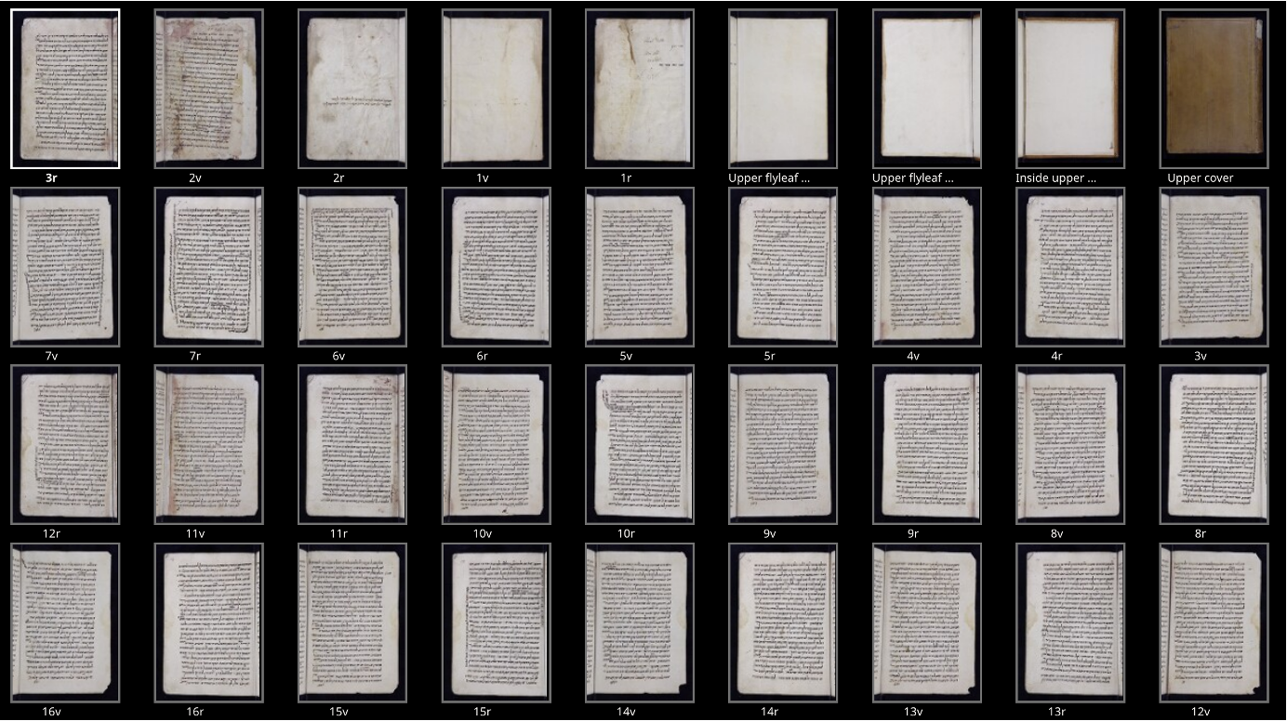
Problem Statement
How many scribes scribed?
Notes:
Let's briefly touch upon a traditional method often used in document analysis and sometimes adapted for paleography: the Bag-of-Words
First, we extract local features or keypoints – think of these as small, distinct visual patterns. For instance, SIFT descriptors are commonly used.
Second, we take all these features from a representative set of images and cluster them to create a 'visual vocabulary' or codebook. Each cluster center represents a prototypical visual 'word'.
Third, any given page is then described by a histogram showing how frequently each of these visual 'words' appears on it.
Finally, to compare two pages, we compare their histograms. Pages with similar histograms are considered visually similar.

Slide 7
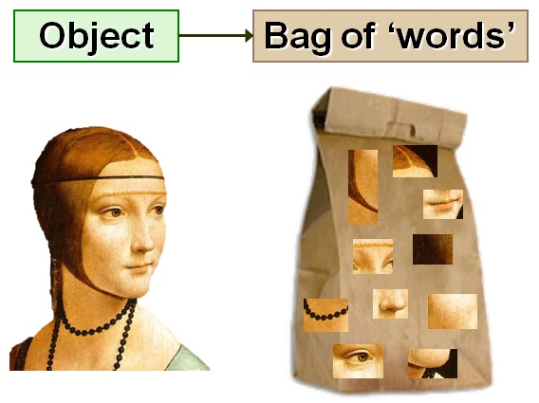
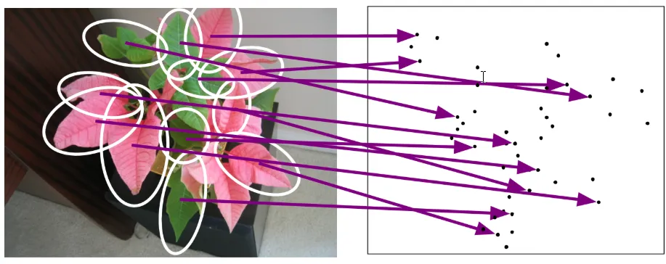
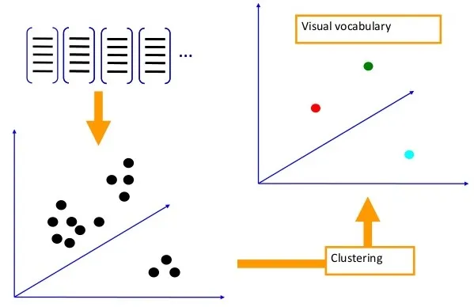
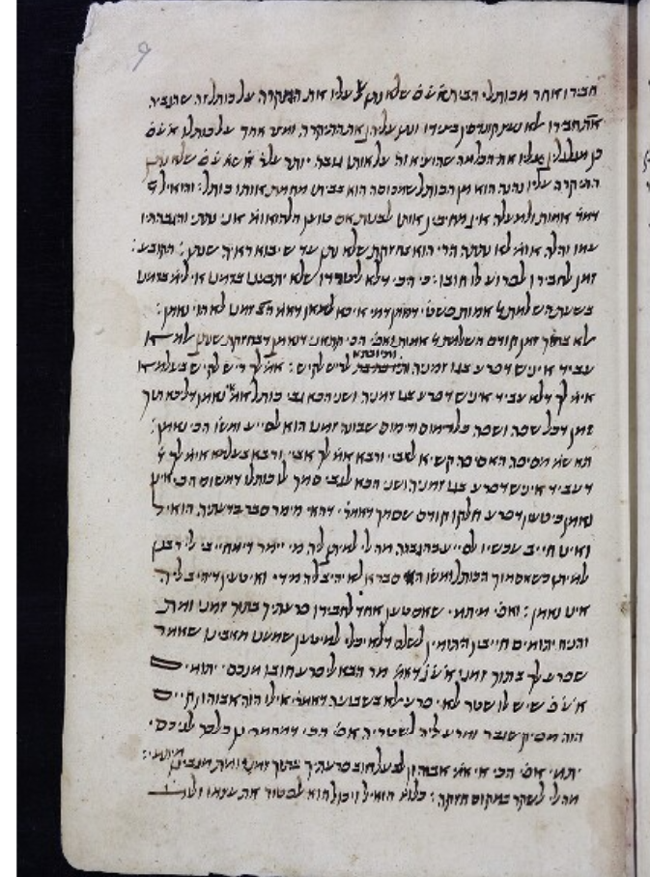
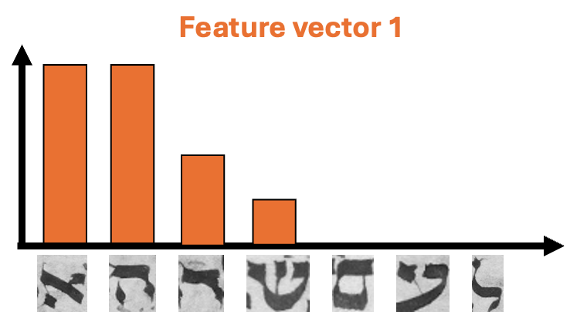
What is the Bag-of-Words (BoW) Method?
A document image is treated as an unordered collection ("bag") of its "words" (features)
Feature Extraction
Visual Vocabulary Construction
Histogram of Features
Notes:
Let's briefly touch upon a traditional method often used in document analysis and sometimes adapted for paleography: the Bag-of-Words
First, we extract local features or keypoints – think of these as small, distinct visual patterns. For instance, SIFT descriptors are commonly used.
Second, we take all these features from a representative set of images and cluster them to create a 'visual vocabulary' or codebook. Each cluster center represents a prototypical visual 'word'.
Third, any given page is then described by a histogram showing how frequently each of these visual 'words' appears on it.
Finally, to compare two pages, we compare their histograms. Pages with similar histograms are considered visually similar.

Slide 8
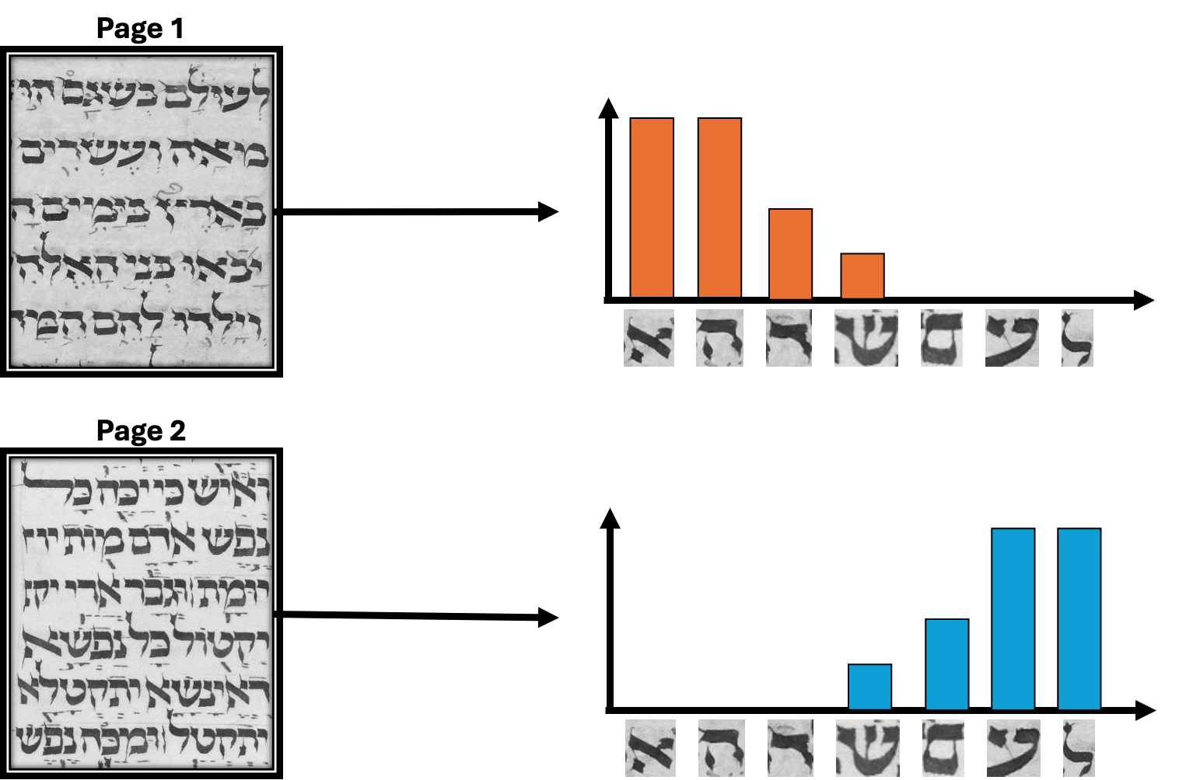
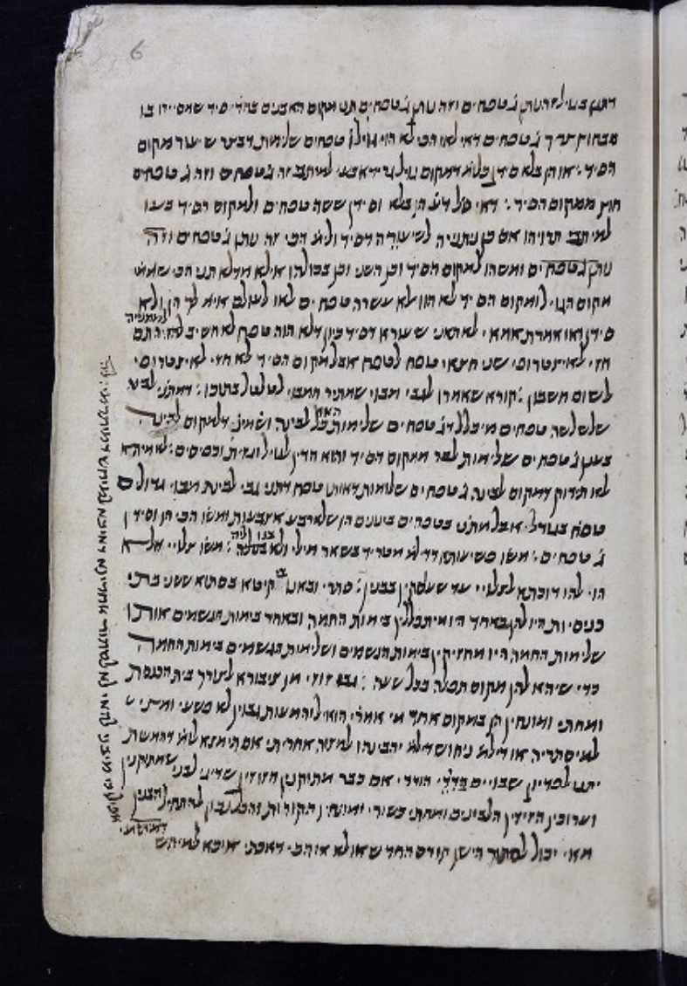
BoW Limitations for Paleographical Similarity
BoW uses fixed features but the set of letters often differ.
Same scribe, different content leads to varying occurrence frequency
Notes:
While BoW is powerful in some contexts, it faces significant challenges when applied to distinguishing scribal hands based on paleographical similarity.
Firstly, BoW typically assumes a fixed set of features for comparison. The number and specific letters present on a page differ greatly, which means their BoW representations can differ even if the handwriting style is identical. Lets say aleph can occur 10 times on one page and 15 in other
Secondly, determining the right number of 'visual words' for the vocabulary is a tricky parameter. There's often no principled way to set this, and it can impact the results.

Slide 9
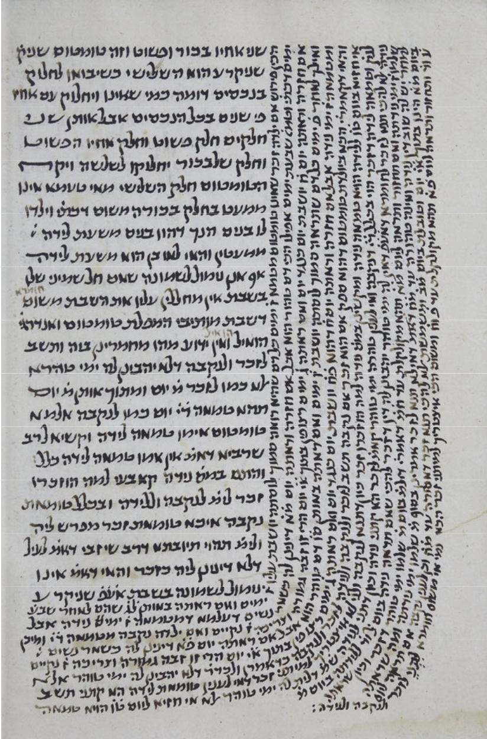
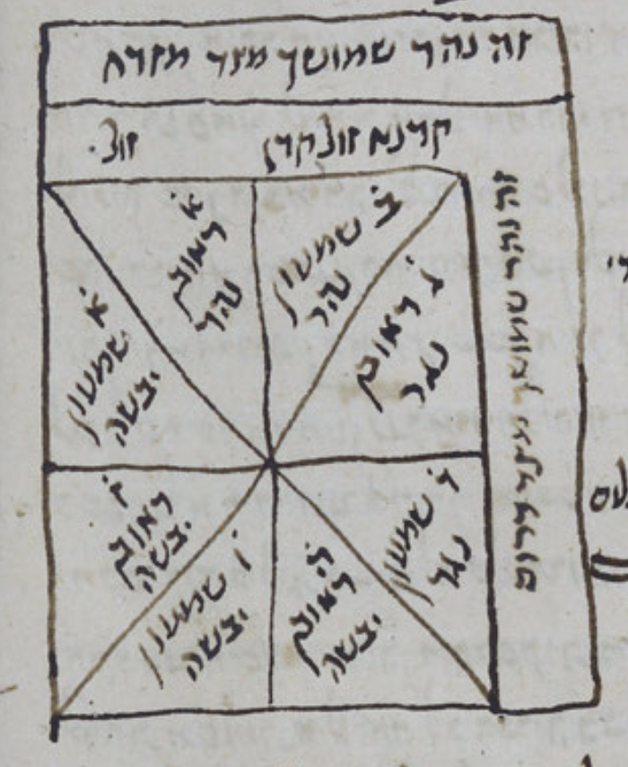
BoW Limitations for Paleographical Similarity
Loss of Salient Infrequent Features : Globally infrequent features does not form a visual word but could be important paleographically.
Notes:
Finally, crucial but infrequent paleographical features that truly distinguish a scribe might not be frequent to form their own distinct 'visual word' in the BoW vocabulary. They can be lost among more common features, diminishing their discriminatory power.

Slide 10
Our Solution: Letter-Level Paleographical Similarity
Instead of page-level comparison, we analyze similarity at the individual letter level
While page content varies, a scribe tends to write instances of the same letter (e.g., Aleph, Bet) with consistent idiosyncratic features.
Comparing an "Aleph" to an "Aleph" is more direct and robust than comparing entire pages.
We focus on matching these shared features (e.g., using SIFT keypoint matching) between letter instances to quantify their similarity.
Notes:
To overcome these limitations, we propose to move from page-level analysis to letter-level paleographical similarity.
The intuition here is that while the overall content of pages written by a scribe can vary wildly, the way they form individual letters tends to be much more consistent. These individual letterforms carry the scribe's unique handwriting signature.
So, instead of comparing heterogeneous pages, we aim to compare like with like.
For example, we compare a group of Alephs from one page with a group of Alephs from another.
We use techniques like SIFT to find low level features between letter instances. The similarity between two letter instances is then based on how many such features robustly match. Crucially, it's the matching features between two letter samples that drive the similarity, not necessarily the internal frequency of any single feature within one letter.

Slide 11
Our approach to analyzing paleographical similarity is based on letter-level rather than page-level analysis. Traditional methods, such as the bag of words model, face challenges in paleography because they assume a consistent number of features per object, which does not hold for handwriting at page level. Since we aim to make letter-level comparisons, we face the challenge of letter detection. Training a machine learning model is not feasible due to the additional challenge of data annotation. Therefore, we adopt an approach inspired by how a nonreader of a text would compare handwriting: by looking at repeating shapes regardless of their identity. We begin by detecting all the connected components on a manuscript page. We then perform pairwise Scale-Invariant Feature Transform (SIFT) matching among all component combinations. A SIFT match is defined as having at least m feature matches between two components, each satisfying the Lowe ratio test with a threshold r. Using a union-find algorithm, we group the matched components into g groups, where each group contains c similar shaped components. We then measure the number of similar components(s) between two pages of the manuscript as a measure of paleographical similarity. While a higher s value suggests stronger similarity between pages, it does not necessarily imply the same scribe, as certain common shapes may appear frequently by chance. Our goal is to refine this metric to account for scribal attributions.

Slide 12
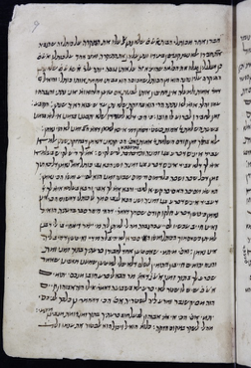
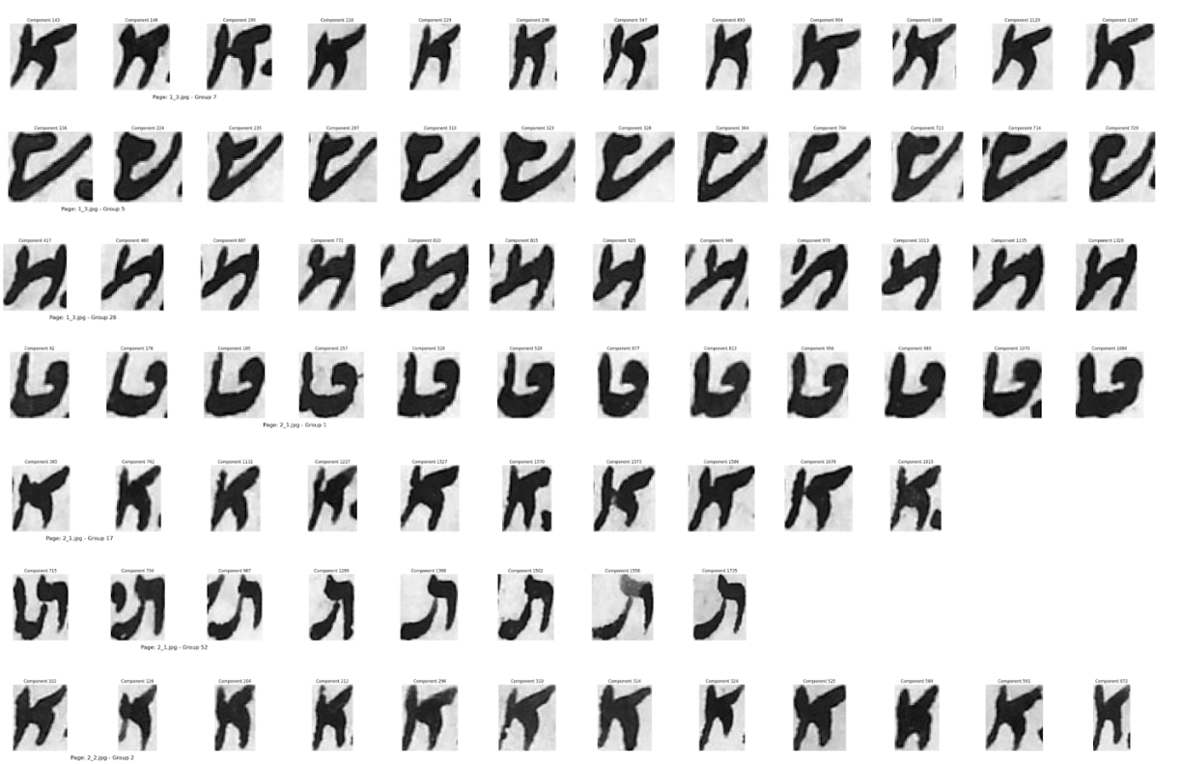
Our Solution : Letter Cropping
Notes:
Our algorithm processes each page page and automatically crops out individual letter instances.
After that for each page we take all its cropped components and cluster them into lets say 'g', number of groups lets say 22 as for each hebrew character For eg: all the Alephs on that page will cluster together, all the Bets together, and so on.
We also observe some noisy components within clusters. When applying the Hungarian algorithm, these noisy elements typically do not align well with any true letter instances, resulting in no valid match.
Importantly, these groups are unlabeled; we don't know which group corresponds to which actual Hebrew letter.
What you're seeing here are some example groups of cropped letters, grouped by character type.

Slide 13
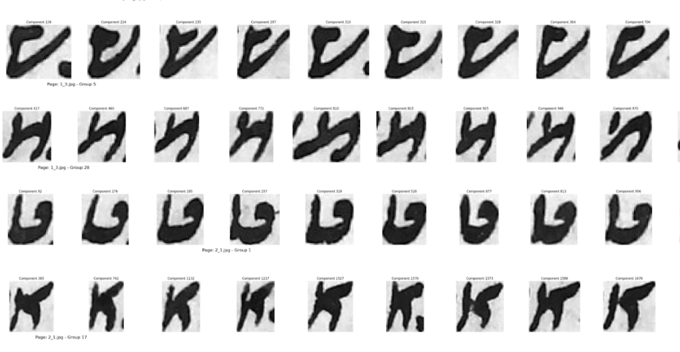
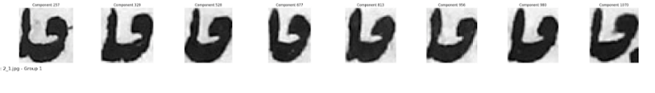
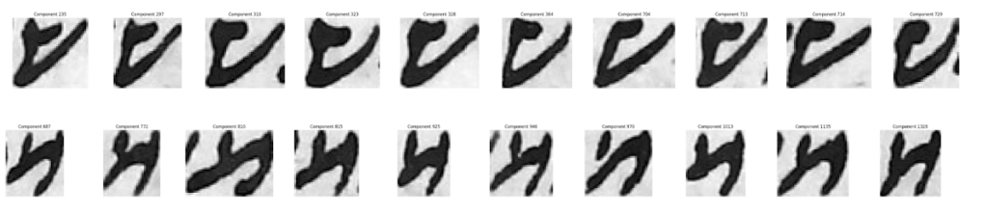
Our Solution : Finding Corresponding Groups by counting the number of similarities between the corresponding letter groups.
Page A
Page B
Notes:
After that We find matching groups between 2 pages using hungarian algorithm

Slide 14
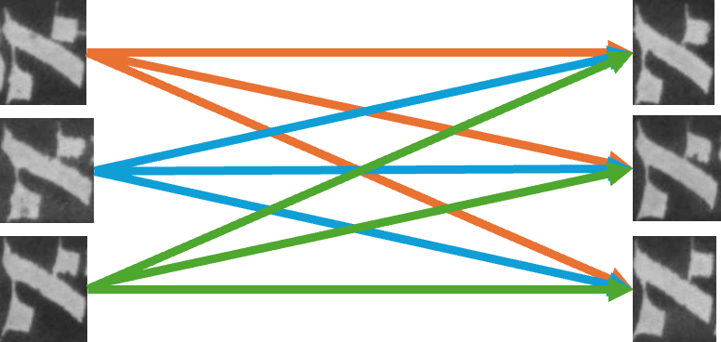
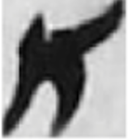
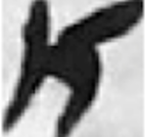
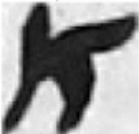
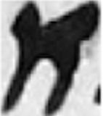
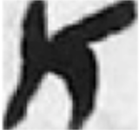
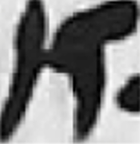
Our Solution : connected components
We count the number of similarities between the corresponding letter groups. As much as the number of similarities, as much as these two pages are written by the same scribe.
Similarity Score
Notes:
After this the algorithm finds the best one-to-one matching between the groups from Page A and Page B that maximizes the total similarity.

Slide 15
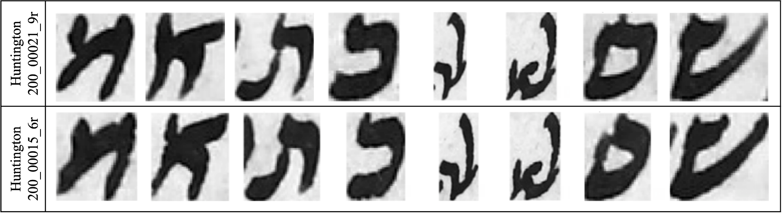
Preliminary Results: Huntington 200
Our method provides evidence that aligns with Judith Schlanger’s codicological and paleographical study (identifying six scribes).
This contrasts with the SfarData database attribution of eleven scribes.
We observe that certain letters are consistently written in the same way across pages that SfarData attributes to different scribes, suggesting these pages might actually be by the same hand.
Notes:
Our preliminary results are quite promising.
They tend to support the findings of Judith Olszowy-Schlanger, who, through traditional paleographical analysis, identified six scribes.
This is notably different from the eleven scribes listed in the SfarData database.
Our method has shown instances where specific letters maintain a consistent style across pages that SfarData attributes to be different scribes.

Slide 16
Thank you

